Slide 1



Workshop: Toward a Common Protocol for Testing Carbon Stability of Hydrochar
Silvia Román Suero
Postdam, 17th July 2025

Slide 2
Workshop motivation:
Provide basis for hydrochar to be included as Negative Emission Technology in carbon markets
Some current standards
1. Isometric Protocol for durable carbon removal through BiCRS (Subsurface Biomass Carbon Removal and Storage)
Purpose: Methodology to for calculating durable subsurface storage biomass removal for 1000 years; estimate the durable carbon stored during that same time scale; requirements for ensuring storage sites are protected and undisturbed.
Applied to no marketable forest residue, agricultural crop residue or animal waste. Biomass placed at depths of no more than 100 m below the ground surface.
2 scenarios for storage:
Subsurface Storage
(mining areas
and others…)
Closed systems
(bottles
containers, tanks)
2. Standard for the Certification of Biochar-Based Carbon Sinks (Global Biochar C-Sink Standard 3.0)
Purpose: Ensure reliable, measurable and durable CDR. It aims making biochar a valid and scalable NET (Negative Emission Technology); it supports the creation of certified carbon sink units that can be used in regulated carbon markets.
Applied to biochar produced from agricultural and forestry residues, and industrial by-products. Products classified as: C-35, C-50, C-100 (depending on their stability).
Persistent and semi-persistent Aromatic carbon also allows estimating the stability term frame.
Biochar has to be safely stored (…) and not applied to soil unless irreversibly bound (under roads or concrete)

Slide 3
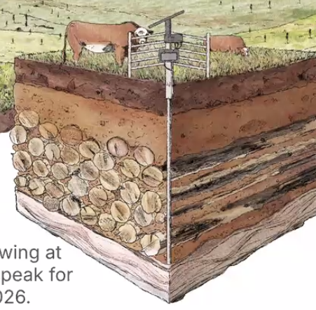

Examples for biomass storage: Ground
Factors affecting long-term sequestration of biomass
=> What should be considered for HC storage?
low moisture, lignocellulosic biomass
Storage conditions:
Atmosphere - Anoxic conditions have to be guaranteed to prevent organic matter decomposition by microbial activity
Biomass selection and preparation:
Type of biomass, its moisture content,
aggregation, densification possible
Site preparation :
Biomass is typically buried in trenches or engineered pits designed to minimize oxygen infiltration
Physical Barriers and Sealing Techniques:
Multiple/diverse layers of physical barriers are used:
Clay liners: Natural or engineered clay (e.g., bentonite) is compacted to reduce gas permeability.
Geomembranes: High-density polyethylene (HDPE) or similar synthetic liners are installed over the biomass to create an airtight seal.
Compacted soil: Local soils are pressed over the site to provide structural integrity and limit gas exchange.
Before sealing, the trench or pit is flushed with an inert gas such as nitrogen in some systems
Puro.earth

Slide 4
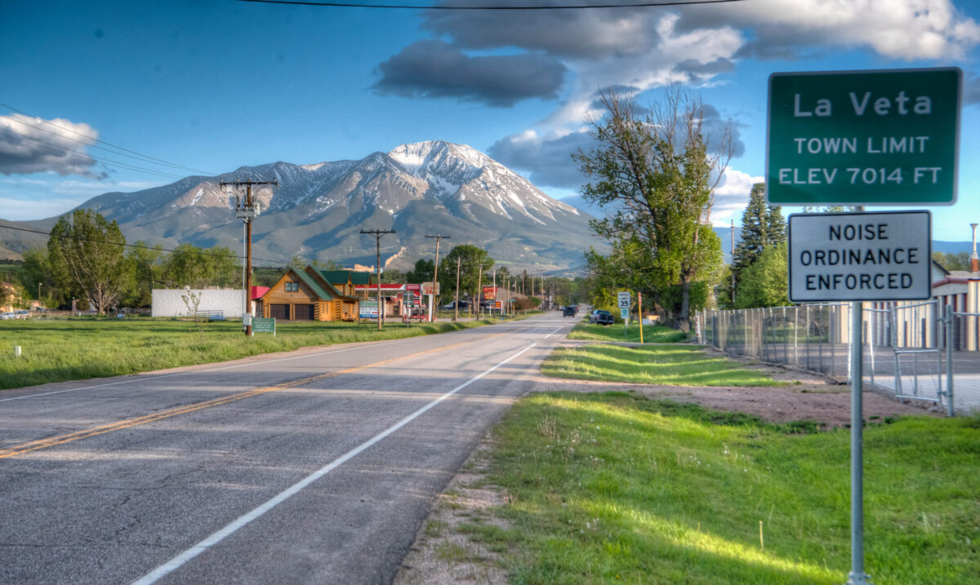
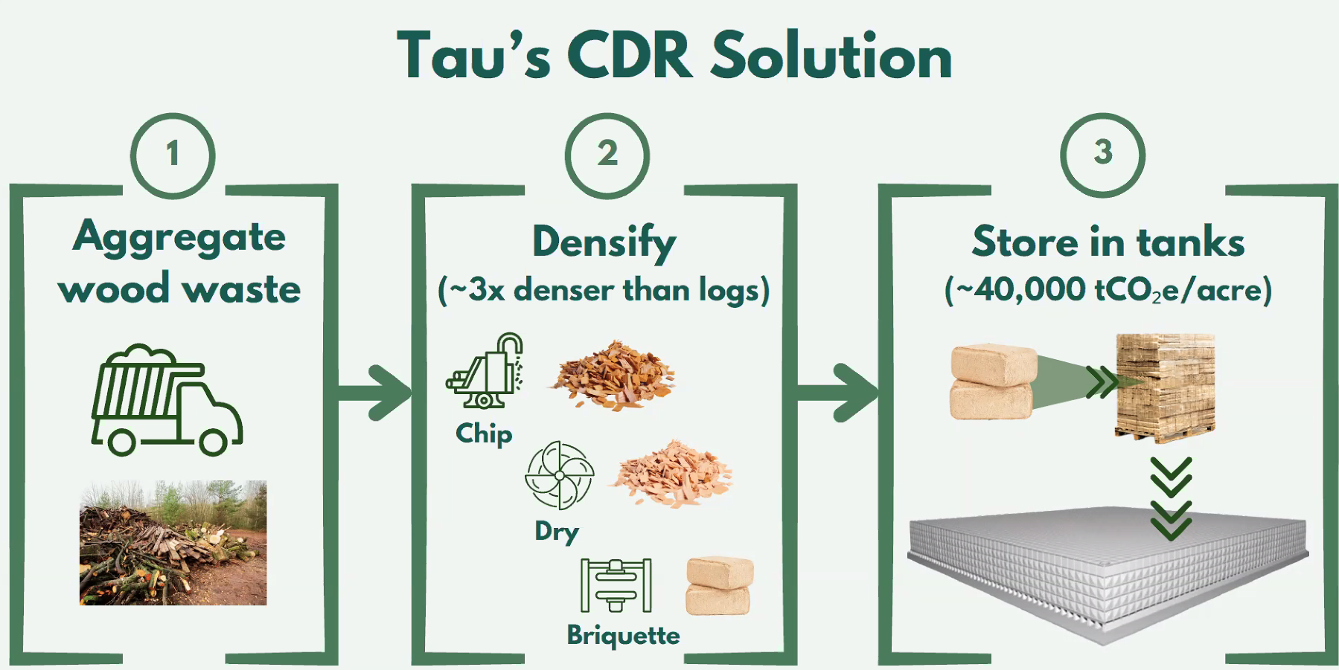
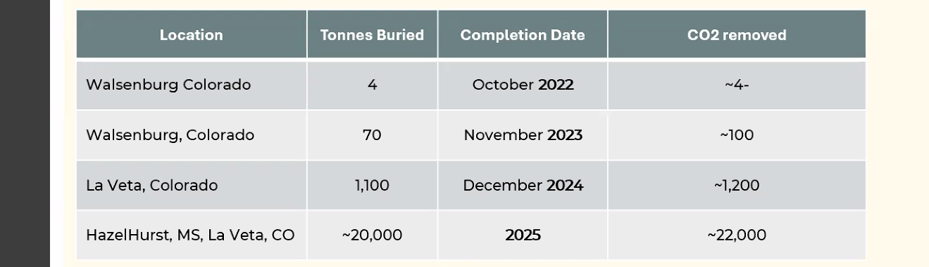
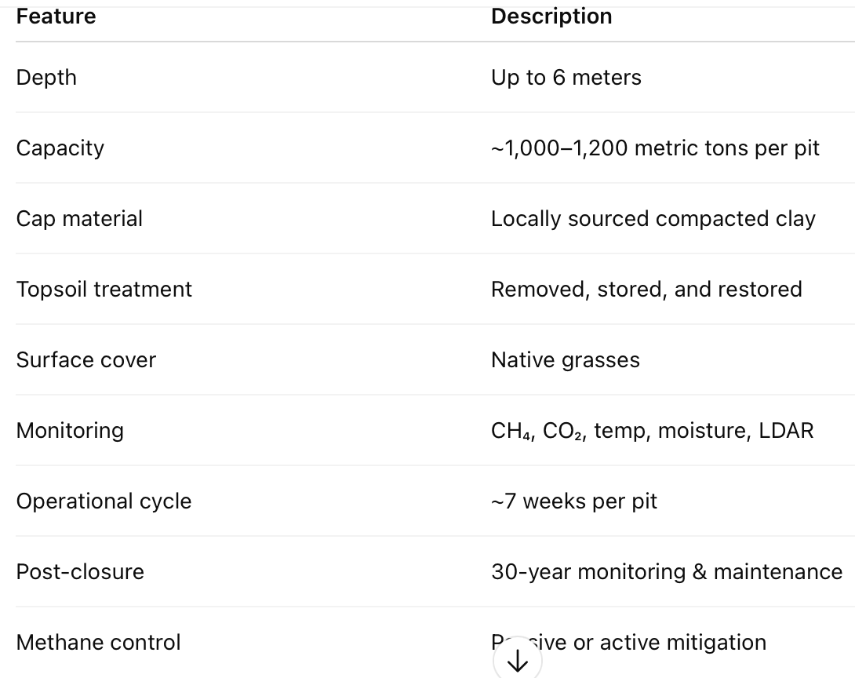
Examples for biomass storage: Closed systems
Factors affecting long-term sequestration of biomass
=> What should be considered for HC storage?
Chipping, drying, pelleting need more energy in the case of biomass than than in the case of HCs
A less complex burial strategy is also more favourable for HCs (less depth, less exigent inert conditions…)
Woodcache, pits of 6m depth,
CDR: Carbon Dioxide Removal
Pilot year (2024): one cell buried, resulting in around 1 100 t CO₂ removed
Notes:
♻️ ¿Qué se incluye en el análisis de carbono?
La metodología de Puro.earth para "Terrestrial Storage of Biomass" exige un análisis de ciclo de vida (LCA) que deduzca las emisiones indirectas del total removido. Estas emisiones incluyen:
✅ Emisiones contempladas:
Transporte de la biomasa
Desde el bosque o zona de cosecha hasta el sitio de enterramiento (camiones, maquinaria).
Distancias medias, tipo de combustible, eficiencia de carga, etc.
Maquinaria para excavación y apilamiento
Consumo de diésel u otros combustibles durante la preparación y llenado de las fosas.
Procesos de secado (si se aplican)
En proyectos como el de La Veta, no se seca artificialmente la biomasa, por lo que estas emisiones suelen ser mínimas o nulas.
Construcción de infraestructuras
Movimiento de tierras, compactación, tapado con arcilla y revegetación.
Monitorización y mantenimiento post-cierre
Incluye consumo eléctrico de sensores, visitas técnicas, etc.
📉 ¿Cómo se aplican?
Se restan del total de CO₂ capturado, dando como resultado la "net removed CO₂".
En el caso de La Veta:
Aunque se capturan aprox. 1,1 t CO₂ por tonelada de biomasa, el valor neto tras deducciones puede rondar 0,8–1,0 t CO₂/ton biomasa (según condiciones específicas).

Slide 5
Structuring the protocol for measuring HC stability
Common stability criteria for biomass | Aspect | Keys and open questions..
Ground (depth < 100 m) or Closed systems | Storage conditions | Subsurface? depth? Inert gas feeding? Soil properties? How to guarantee permeability? clay layers?
Periodic inspection or long-term modeling of gas movement and degradation rates (this is made by Tau company at biomass burial) and CO₂ or CH₄ leaking | Monitoring the system emissions | Gas leaking measurements? What equipment? infrared cameras? Respirometry? How often? Gas chromatography?
high %C_{org} ? low labile C!; low H/C ratio | HC stability measurements | H/C, H/C_{org} | O/C, N/C?
Biomass water content, < 15% | HC stability measurements | Water content | < 10%
Surface reflectance | HC stability measurements | Surface reflectance | ?
 | HC stability measurements | C fractionalization studies; estimation of mineralization rate | Chemical procedures (oxidation, digestion…), H₂ pyrolysis Carbon ash recalcitrance?
 | HC stability measurements* | Properties affecting combustion performance | Thermal stability (TGA, DSC…), HHV, ash content
 | HC stability measurements* | Changes on chemical surface composition | FT-IR, XPS, NMR…
 | Hydrochar stability measurements* | Properties affecting nutrient/mineral mobilization-speciation in soil | P, N, K, Mg..
 | Hydrochar stability measurements* | Textural modifications | Gas adsorption, SEM
*Intended to be used for scientific purposes, to get insights about the degradation pathways and how they affect final HC properties (Luo et al., 2025)
Notes:
Soil properties (sand, clay, pH..) have an effect on HC stability.
2. Chemical Fractionation of Carbon
Separates carbon into fractions based on chemical or thermal resistance.
Methods:
Oxidation with potassium dichromate or hydrogen peroxide
Acid digestion to isolate recalcitrant fractions
Labile vs. recalcitrant carbon quantification
It is then heated under a continuous flow of hydrogen gas (H₂) in a high-temperature furnace (usually 500–600 °C).
Labile (easily degradable) carbon compounds—aliphatics, oxygenated groups, etc.—are hydrogenated and volatilized.
The solid residue that remains consists of aromatic, condensed, highly stable carbon structures.
This final residue is considered to represent the "pyrogenic carbon" or the most stable carbon fraction in the sample.

Slide 6

Suggest one highlight for structuring the protocol
Notes:
Fritz + Giovanna, Silvia + Daniela, Marc (or fabi) + Gianluigi, Beatrice + JeaWook

Slide 7
Discussion the structure of standard protocol for testing HC stability
BG1 and BG2 work on Scenario 1: subsuface storage
Each group composed of people from different profiles, if possible (research, business, market)
Storage conditions, HC properties and system monitoring
are considered
Researchers should have different expertise (soil, materials, chemistry..)
BG3, BG4 and BG5 work on Scenario 1I: closed system
Notes:
Fritz + Giovanna, Silvia + Daniela, Marc (or fabi) + Gianluigi, Beatrice + JeaWook

Slide 8
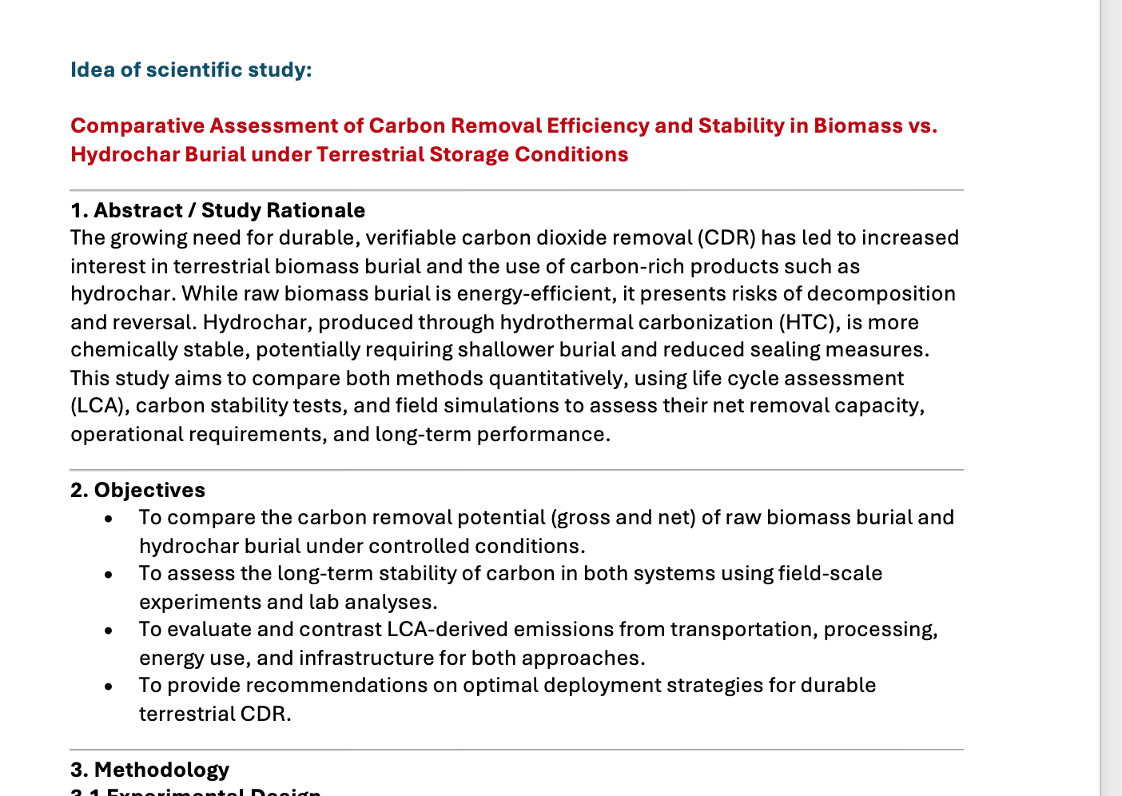
Future goal: Test the protocol → Collect data
Output from our common stability measurements:
Sharing results to broaden basis knowledge on hydrochars from variety of feedstocks
What properties should we measure?
How to design the storage places?
When and how?

Slide 9
Workshop: Toward a Common Protocol for Testing Carbon Stability of Hydrochar
Postdam,
17th July 2025

Slide 10
HC is less stable than pyrochar but provides greater C and P capture
Acosta, A. (2024). Hydrothermal carbonization and pyrolysis in wetland engineering: Carbon sequestration, phosphorus recovery, and structural characterization of willow-based chars with X-ray μ-computed tomography.
Spokas, K. A. (2010). "Review of the stability of biochar in soils: predictability of O:C molar ratio".
Leng et al. (2019). "Biochar stability assessment: methods, findings and research gaps".
Zimmerman (2010). “Abiotic and microbial oxidation of biochar and their influence on biochar stability”.
Wiedemeier et al., 2015. “A molecular–thermodynamic model for the stability of pyrogenic organic matter in soil.”
Meredith et al., 2012. “Hydrogen pyrolysis of charred biomass and soil organic matter: new insights into the nature and stability of pyrogenic carbon.”
Ascough et al., 2010. “Hydrogen pyrolysis: A new method for measuring the stable carbon fraction of charcoals.”
Luo et al., 2025. “Advancing hydrothermal carbonization: Assessing hydrochar’s role and challenges in carbon sequestration”.
Models to predict stability
Microbial activity
Characterization techniques

Slide 11
Workshop: Toward a Common Protocol for Testing Carbon Stability of Hydrochar
Postdam,
17th July 2025
The authors are thankful to Agencia Española de Investigación for the financial help through project PID2020-116144RB-I00/AEI/10.13039/501100011033

