Slide 1
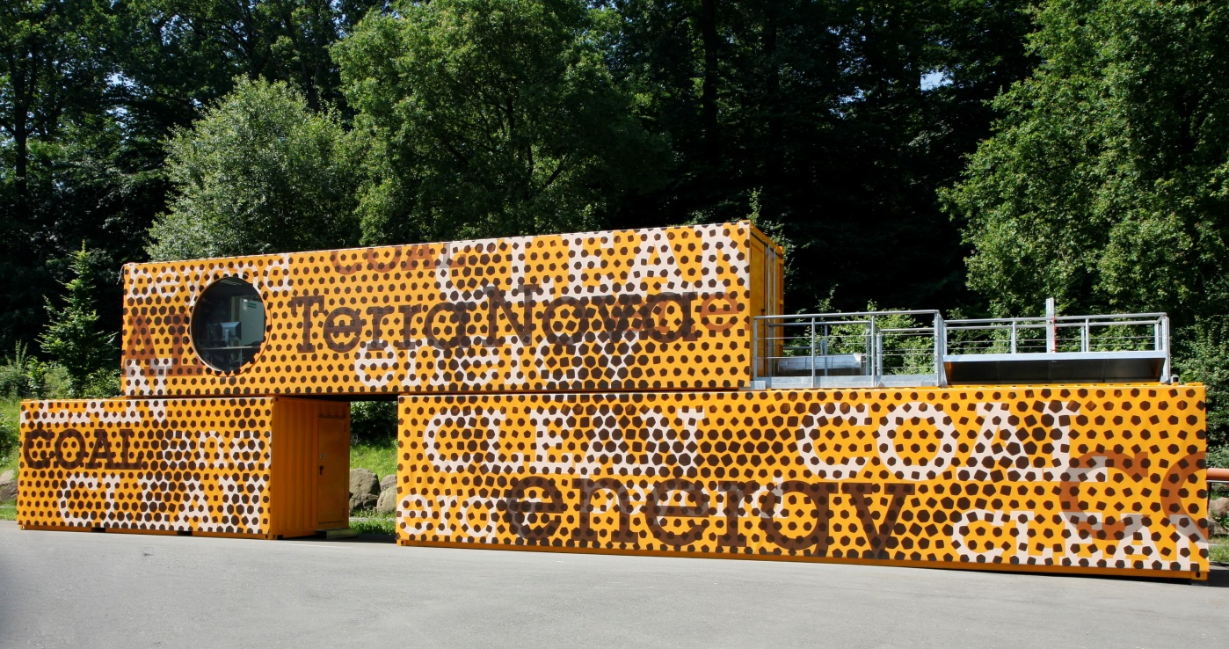
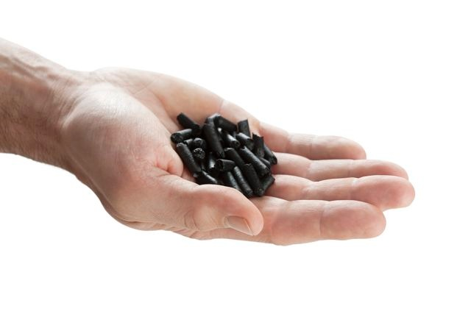


TerraNova Carbon Dioxide Removal (CDR)
Hydrothermal Carbonization = “Wet Pyrolysis”

Slide 2
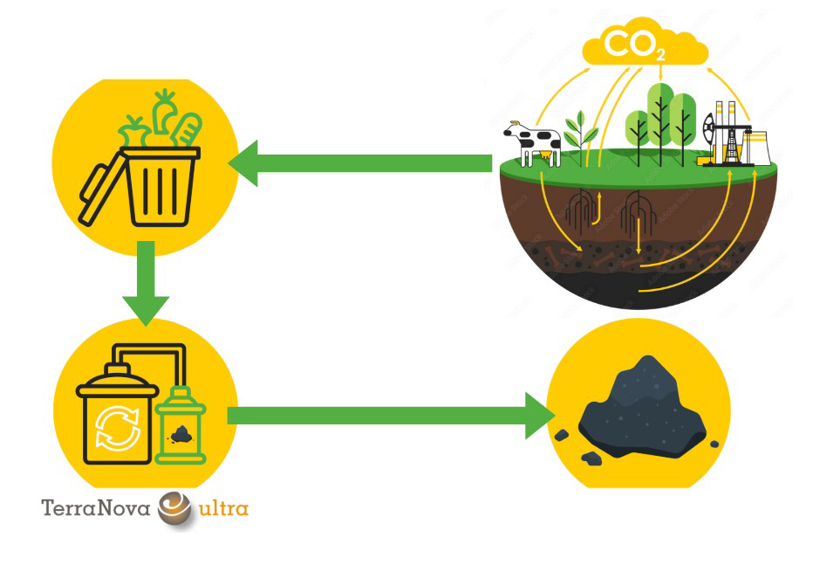
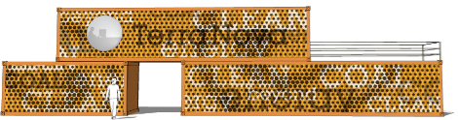
Turn back the carbon cycle with Hydrochar
TerraNova “wet pyrolysis” technology
Wet organic residues
Carbon Cycle
Hydrochar,
safely stored underground
>> 100 years
TerraNova®ultra
„Wet Pyrolysis“
Hydrochar
Carbon Cycle: Adobe Stocks 601996186

Slide 3
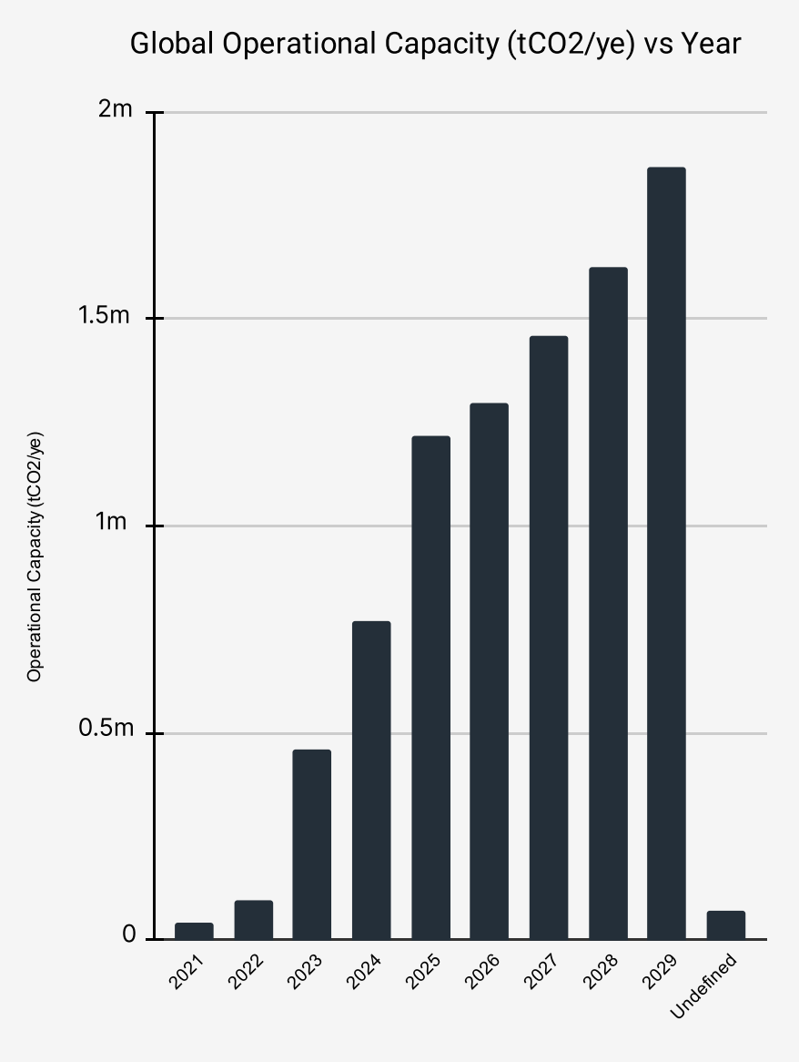
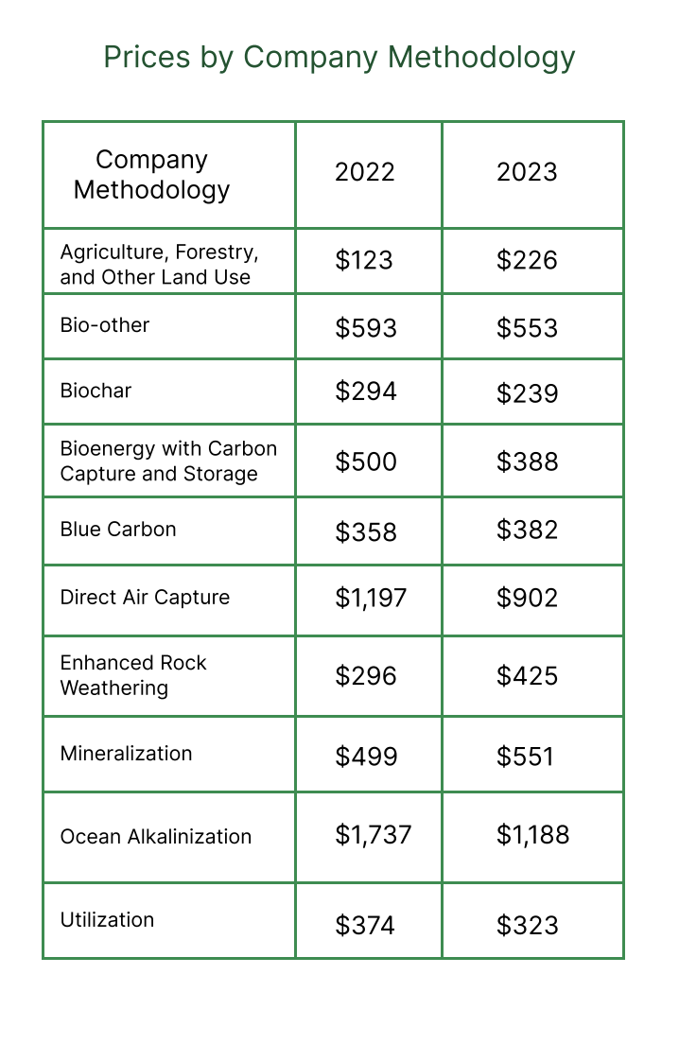
CDR Biochar/Hydrochar – Strong developing Market
> 90% of delivered CDR credits are based on Biochar (Pyrolysis of woody biomass)
Market will triple in size until 2029
Significant cost advantage of TerraNova Hydrochar towards other CDR technologies
* AlliedOffsets, April 2024
-> TerraNova Hydrochar: < $200

Slide 4
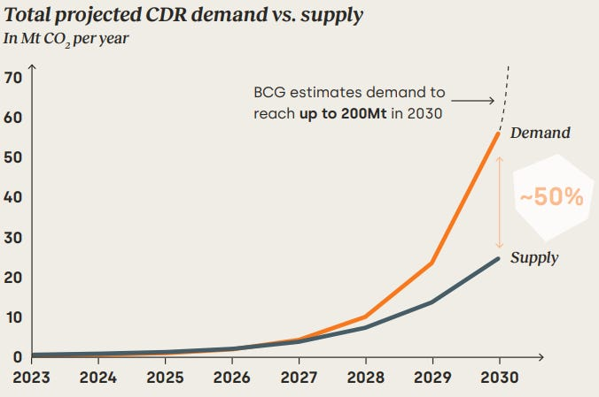
CDR Biochar/Hydrochar – urgently needed climate solution
> 90% of delivered CDR credits are based on Biochar (Pyrolysis of woody biomass)
Market will triple in size until 2029
Significant cost advantage of TerraNova Hydrochar towards other CDR technologies
* World Business Council for Sustainable Development (WBCSD), 2024

Slide 5
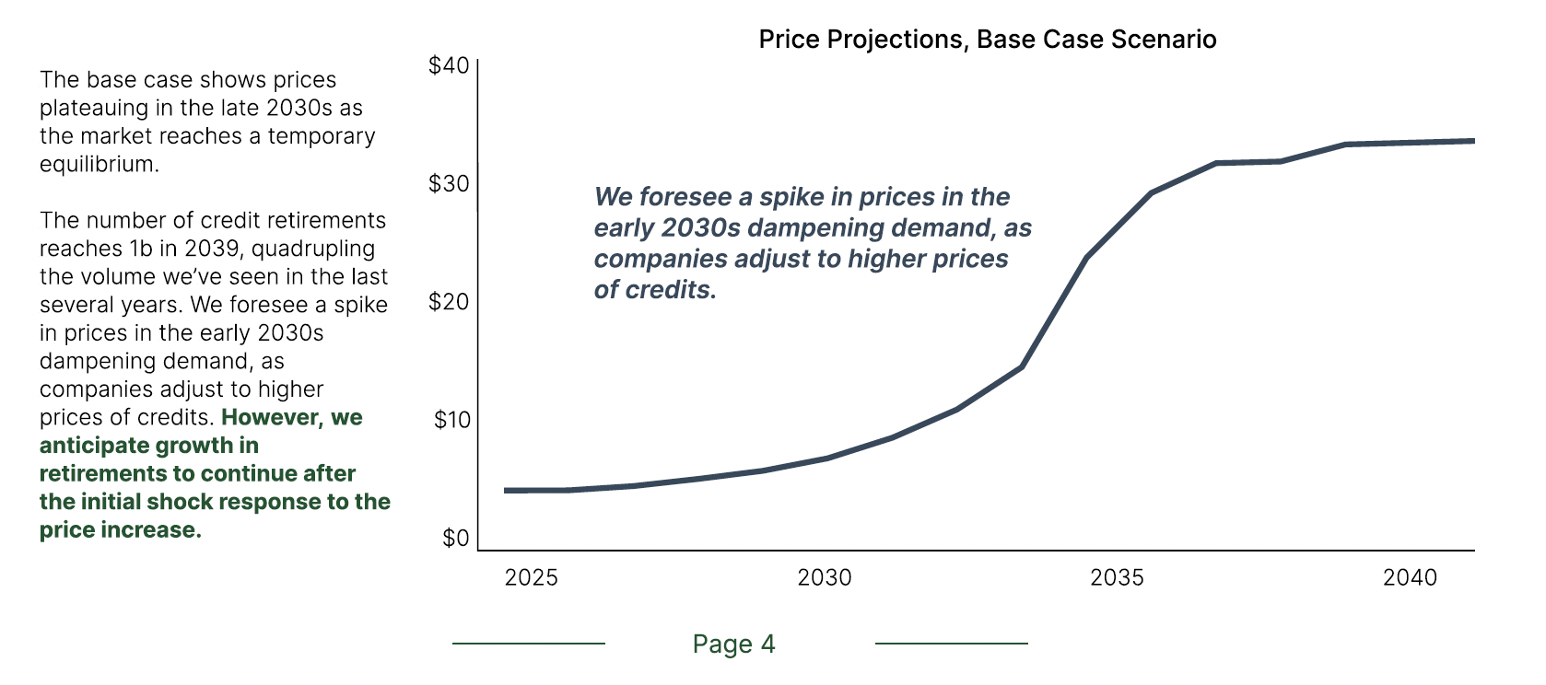
Marketprice of CDR credits is set by demand/supply!
AlliedOffsets- Forecase March 2025

Slide 6
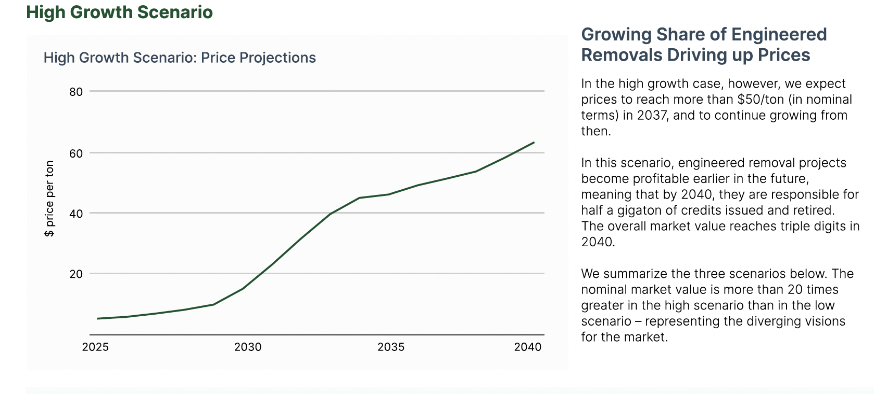
Marketprice of CDR credits is set by demand/supply!
AlliedOffsets- Forecase March 2025

Slide 7
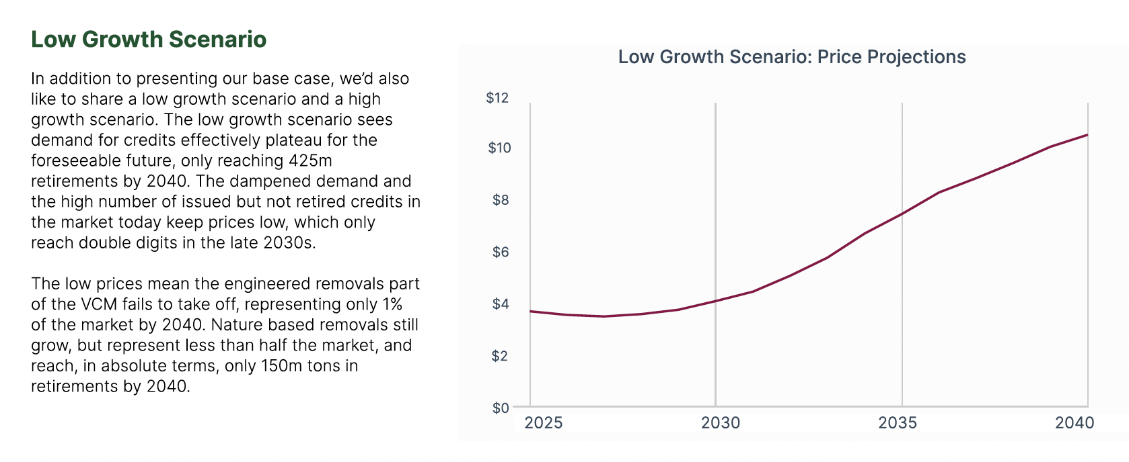
Marketprice of CDR credits is set by demand/supply!
AlliedOffsets- Forecase March 2025

Slide 8
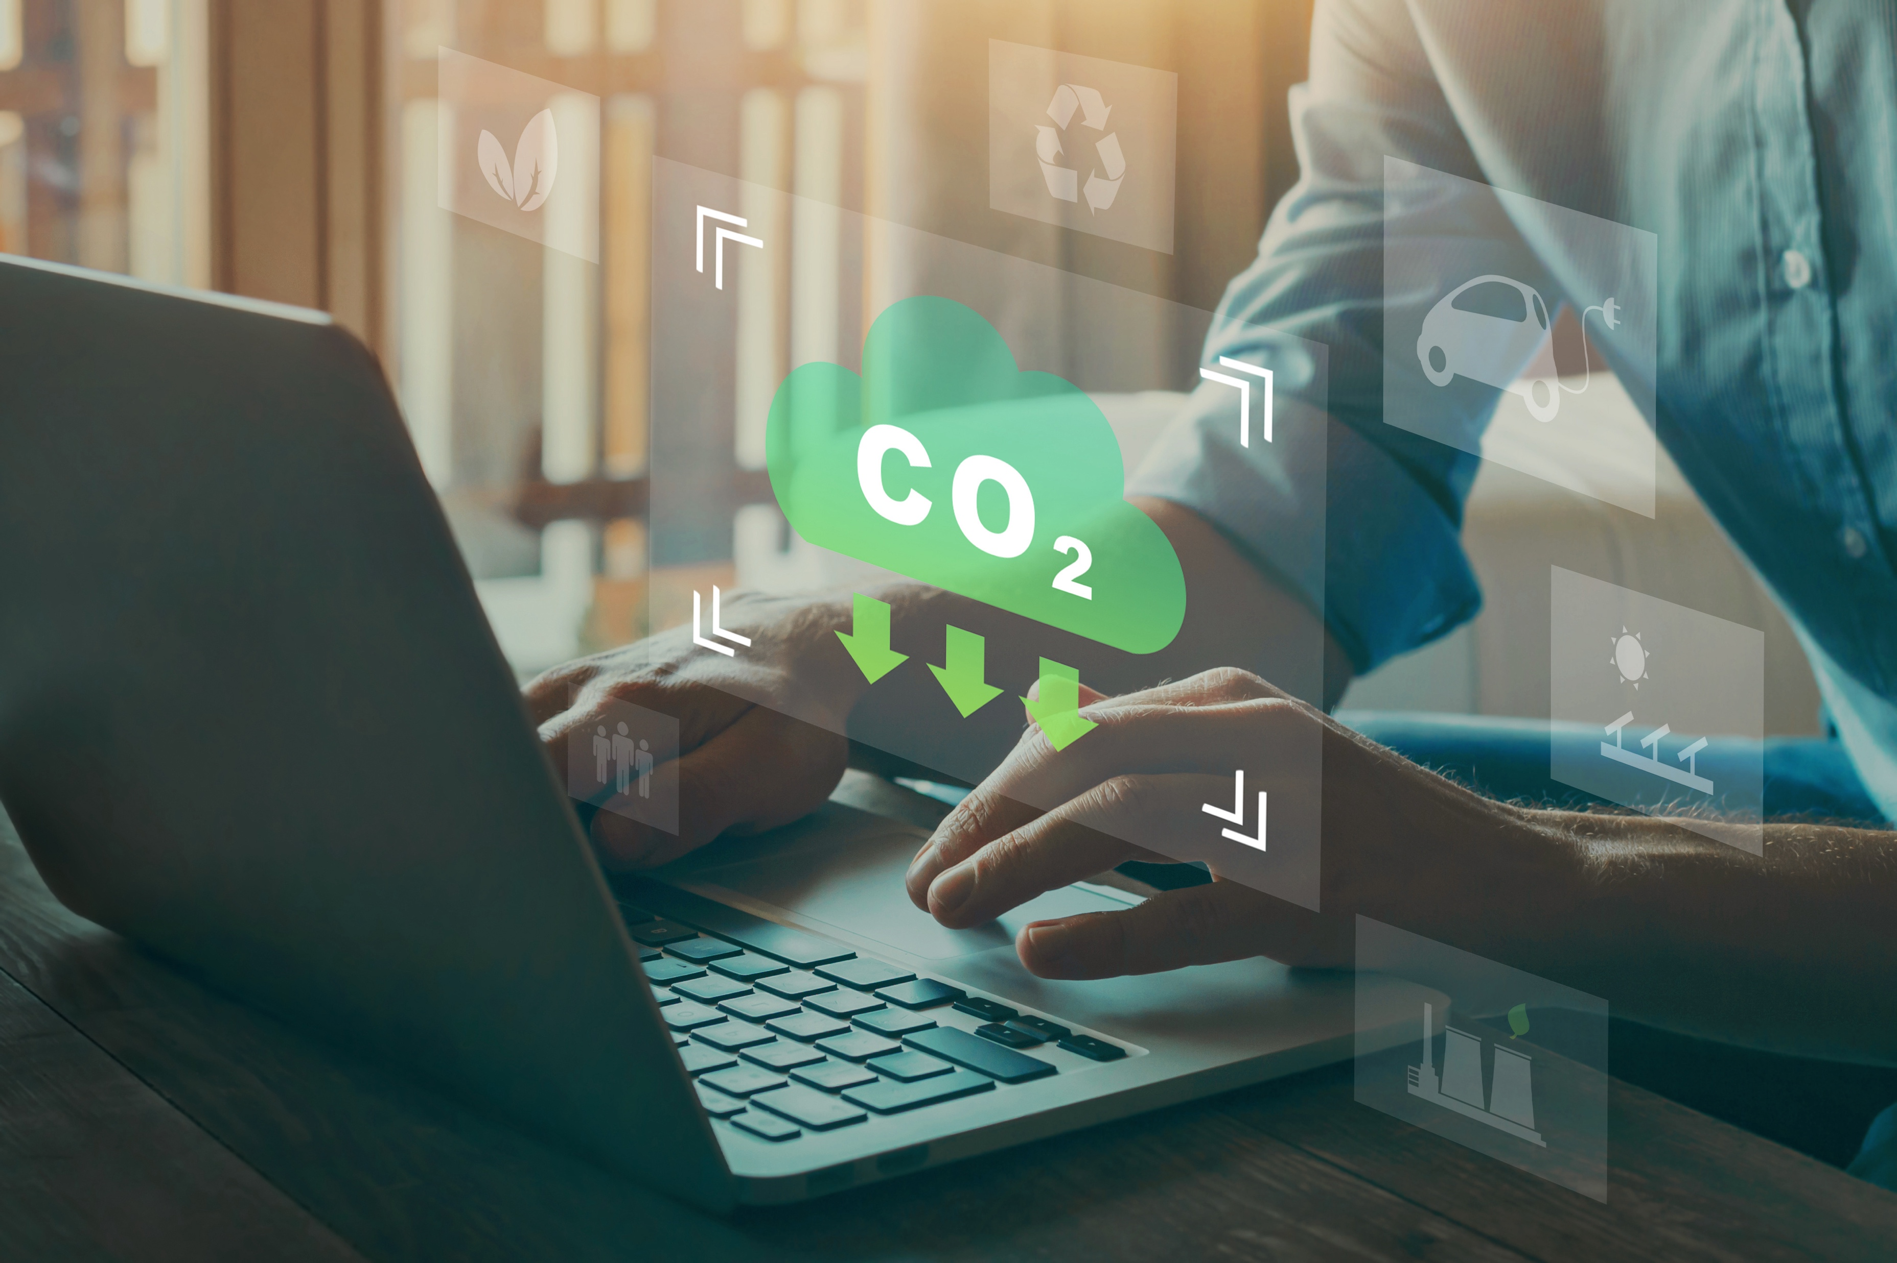
TerraNova wet Pyrolysis – CDR Advantages
Both wet + dry organic residues / sludge as input
>90% of Carbon is captured ( > 2x more than dry Pyrolysis)
Stability of Hydrochar (Volatiles, H/C characteristics) similar to lignite coal
Energy demand 500 – 800 kWh per ton of CO2 captured* (<< 50% less then DAC)
Cost < 200 USD per ton of CO2 captured* (<< 50% less then DAC)
Waste heat / solar heat can provide the process energy
*10 USD landed cost per ton of input biowaste, 20% dry matter content, 50% carbon content (DM)
excluding cost for transportation and geological storage. DAC: Direct Air Capture

Slide 9
Stability of TerraNova Hydrochar
Stability of Hydrochar (Volatiles, H/C characteristics) similar to lignite coal
*Source: Bundesumweltamt August 2015: Daten und Fakten zu Braun- und Steinkohlen Status quo und Perspektiven
(dry matter) | C [%] | H [%] | C [mol] | H [mol] | H/C mol | Volatiles [%]
Lignite (Germany)* | 65-75 | 5-8 | 4,6-5,4 | 5-8 | 1,1-1,5 | 43-60
Hydrochar from Corn Stover Digestate | 52,6 | 5,6 | 3,8 | 5,6 | 1,5 | 63,2

Slide 10
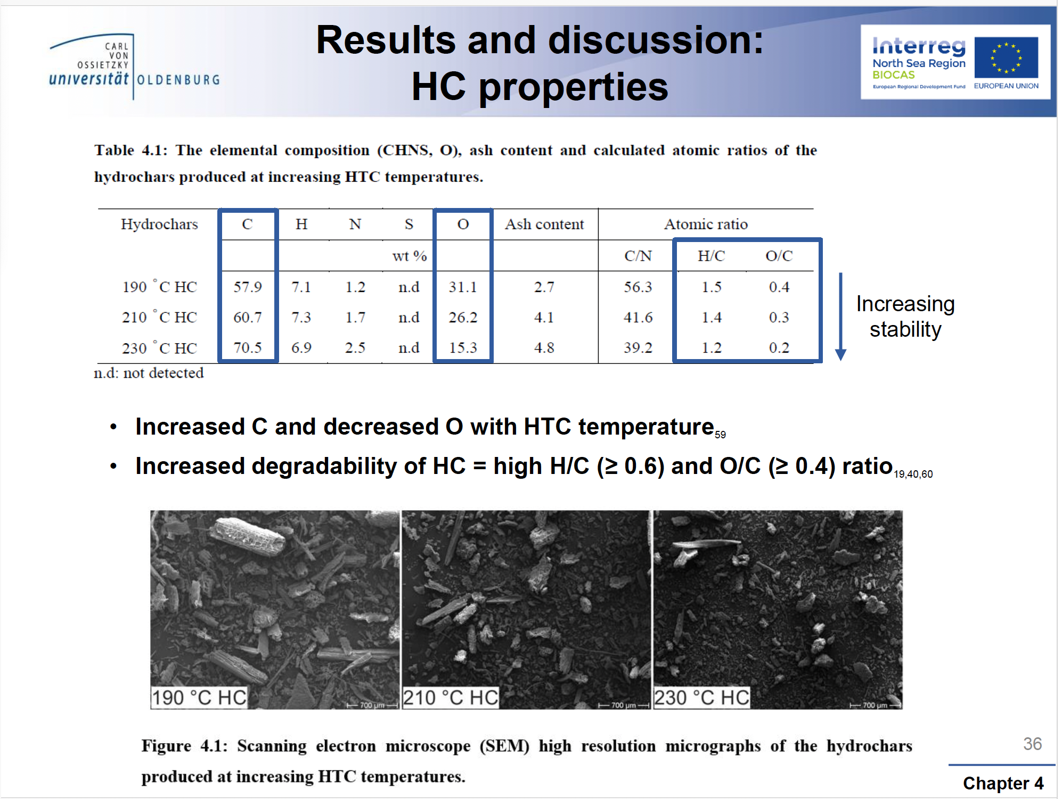
Stability of TerraNova Hydrochar
Stability increases with higher HTC process temperatures
Source: Magan J. de Jager 2021: The potential of hydrochar for soil improvement and carbon sequestration

Slide 11
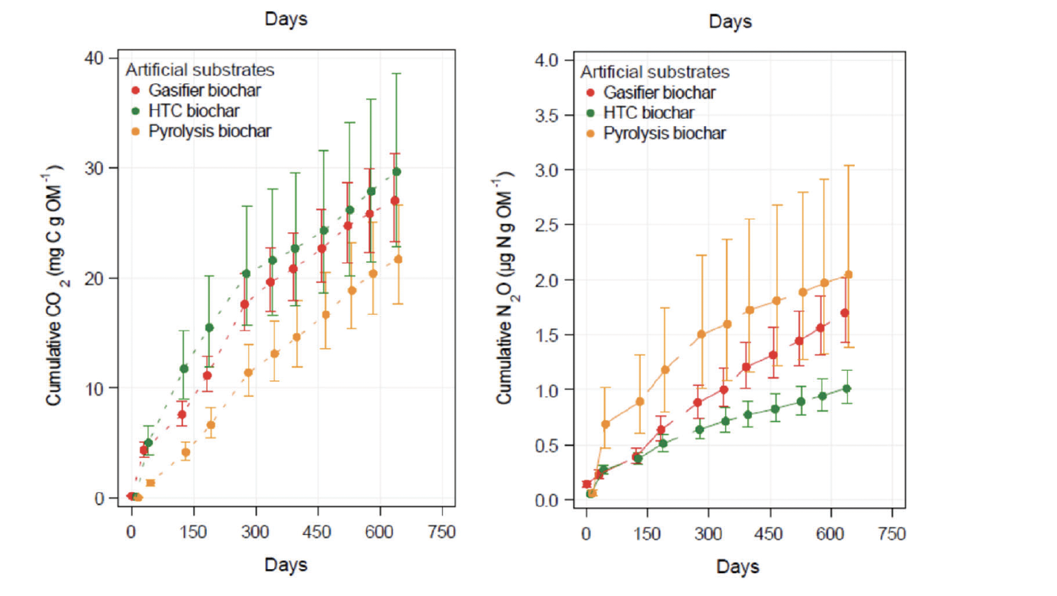
Stability of Hydrochar
Long term release of CO2 similar to Gasifier biochar, moderate higher than Pyrolysis biochar
Long term release of N2O significant lower than Gasifier biochar and Pyrolysis biochar
Note: significant CO2 emissions during production of Gasifier/Pyrolysis biochar
Source: Kern et al., 2022, Short-Term and Long-Term Effects of Natural and Artificial Carbonaceous Substrates on Greenhouse Gas Fluxes

Slide 12
Europe legal framework in force since December 2024:
(EU) 2024/3012 on permanent carbon removals, carbon farming, and carbon storage in products
Different options for Hydrochar:
1. Any practice or process that, under normal circumstances and using appropriate management practices, captures and stores atmospheric or biogenic carbon for several centuries is permitted (Article 2, Point 9).
2. Carbon Farming
3. Carbon Storage in long-lasting products for > 35 years, monitored and regularly certified
- Quality criteria:
1.⁠ ⁠Quantification of the permanent net carbon removal benefit
2.⁠ ⁠Additionality
3.⁠ ⁠Storage, monitoring, and liability
4.⁠ ⁠Sustainability
fast track!

Slide 13
Voluntary market for CDR:
The voluntary market for CDR certificates follows certain certification protocols for BiCRS (“Biomass Carbon Removal and Storage”), for example:
Puro “Terrestrial Storage of Biomass”
Isometric “Subsurface Biomass Storage”
To ensure atmospheric CO₂ removal for >1,000 years, Isometric adheres to Subsurface Biomass Carbon Removal and Storage guidelines for biomass burial:
Maintaining biocoal moisture content ≤10%
Selecting burial sites with optimal hydrological and geological characteristics
Implementing protective measures including:
  Durable synthetic liners
  Compacted earthen barriers
Validating sequestration through:
  Controlled analog test beds
  Continuous GHG emission monitoring

Slide 14
Test protocol wish list of TerraNova Energy GmbH:
- tests of different types of Hydrochar with variations on process severeness, input waste biomass and addition of acid (I understand that low pH material is less subject to biological decomposition)
- measurement of H/C, O/C, N/C and surface reflectance against Pyrochar with H/C< 0,7 and H/C<0,3 as reference
- long term GHG emissions of dry Hydrochar (<15% water), safely stored (not in soil) against Pyrochar with H/C< 0,7 and H/C<0,3 as reference under accelerated climate conditions
- C balance from raw material to Pyrochar and Hydrochar

