Slide 1



Biocarbon Stability Standards - A Short Review Hydrochar Stability Workshop
Jeremy Taylor Chief Technology Officer
SoMax Circular Solutions July 17, 2025

Slide 2
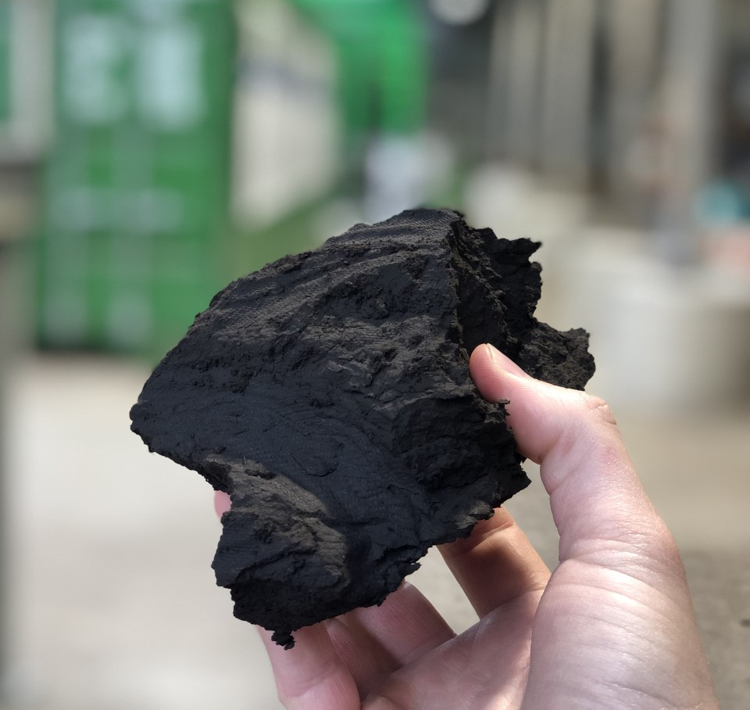
Agenda
Overview of Key Standards and Methodologies
How Stability is Measured Across Frameworks
Hydrochar Limitations with Current Evaluation Methods

Slide 3
Standards and Methodologies
ASABE X### – Method of Measurement and Testing of Biochar
Active Development – Not Published
ASABE – American Society of Agriculture and Biological Engineers
U.S. based standard
ISO 17### – Pyrogenic Biocarbon
Active Development – Not Published
ISO – International Organization for Standardization
Puro.earth – Terrestrial Storage of Biomass – Methodology for CO2 Removal
Published and Available for Carbon Removal Credits
Woody Biomass Burial or Storage

Slide 4


ASABE – Method of Measurement and Testing of Biochar
Core focus is Biochar for ‘carbon preserving purposes’
Excludes energy or industrial applications
Includes all feedstocks
Permanence assessed with three methods:
H/C_{org} Molar Ratio -
O/C_{org} Molar Ratio -
Random Reflectance – Per ISO 7404-5
Methods for the petrographic analysis of bituminous coal and anthracite – Part 5: Method of determining microscopically the reflectance of vitrinite
$$\frac{\text{\% }\text{Hydrogen} \text{Dry} \text{Basis}\text{ / 1.0079}}{\text{\% }\text{Corg} \text{Dry} \text{Basis}\text{ / 12.011 }}$$
$$\frac{\text{\% }\text{Oxygen} \text{Dry} \text{Basis}\text{ / 15.999}}{\text{\% }\text{Corg} \text{Dry} \text{Basis}\text{ / 12.011 }}$$

Slide 5
ISO – Pyrogenic Biocarbons
Core focus is Biocarbons for Agricultural and Industrial Applications
Excludes fuel energy applications
Permanence assessed with three methods:
Inertinite Content – ISO 7404-5: Methods for the petrographic analysis of bituminous coal and anthracite – Part 5: Method of determining microscopically the reflectance of vitrinite
H/C_{org} Molar Ratio – ISO 16948: Solid biofuels — Determination of total content of carbon, hydrogen and nitrogen
Fixed Carbon – ISO 21626-1: Soil improvers and growing media — Biochar — Part 1: Requirements and characteristics

Slide 6
ISO – Carbon Stability
Property Term | Unit | Class 1 | Class 2 | Class 3 | Class 4 | Class 5
Inertinite | % of organic carbon in mass | ≥ 95 | 90 – 95 | 85 – 90 | 75 – 85 | <75
H/C_{org} | Molar ratio | <0.4 | 0.4 – 0.5 | 0.5 – 0.6 | 0.6 – 0.7 | ≥0.7
Fixed Carbon | % in mass | ≥ 90 | 85 – 90 | 80 – 85 | 70 – 80 | <70

Slide 7
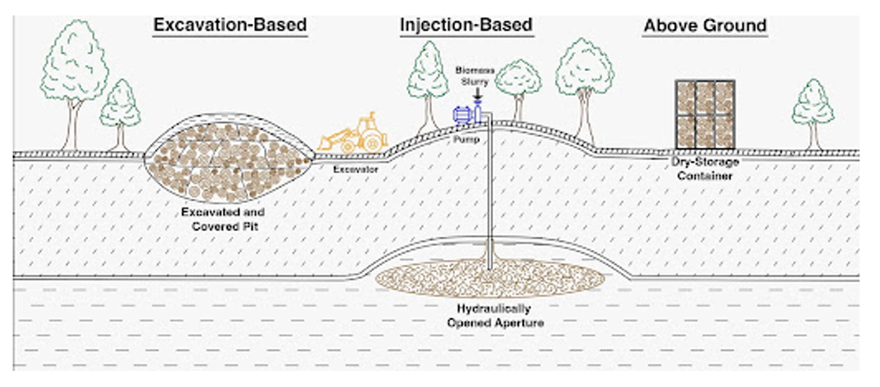
Puro.earth – Terrestrial Storage of Biomass

Slide 8
Puro.earth – Terrestrial Storage of Biomass
Core focus is long term storage (>100 years) of wood or woody biomass.
Requirements: Eligible Feedstock – Woody or woody biomass with rigid physical structure and high lignin content
C:N Mass Ratio – Higher than 80*
*Unless the storage reliably excludes liquid water, such as under permanently frozen or dry (xeric) conditions

Slide 9
Hydrochar Limitations with Current Frameworks
Property Term | Unit | Class 5 / Or Standard | Hydrochar Upper Range | Hydrochar Typical Range
Inertinite | % of organic carbon in mass | <75 | Unknown | Unknown
Fixed Carbon | % in mass | <70 | 45 – 50 | 15 – 30
H/C_{org} | Molar ratio | 0.7 | 0.85 – 0.9 | 1.2 – 1.4
O/C_{org} | Molar ratio | 0.2 | 0.15 – 0.2 | 0.2 – 0.4
C/N | Mass ratio | 80 | 70 – 100 | 15 – 20

Slide 10
Conclusions
Hydrochar typically does not meet the requirements for carbon permanence and stability
Terrestrial Storage shows the most potential to use Hydrochar as a carbon sequestration media.
Industries seem to write standards that fit their specific product.
Jeremy@somaxhtc.com

