Slide 1
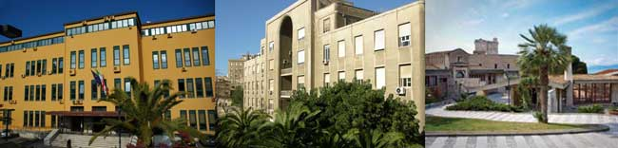
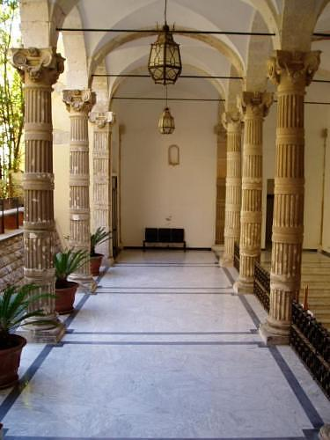
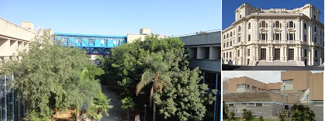
University of Cagliari

Slide 2
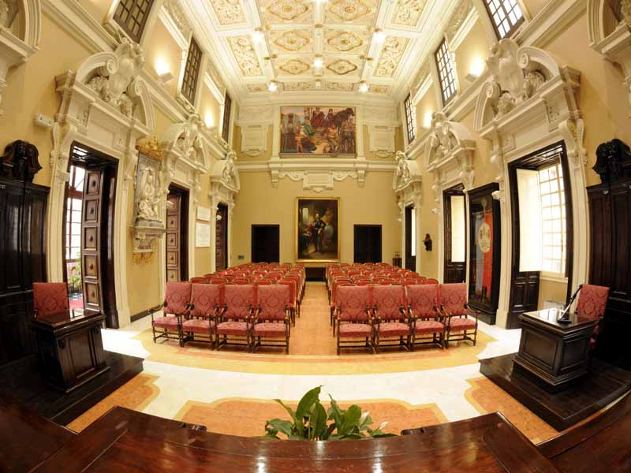
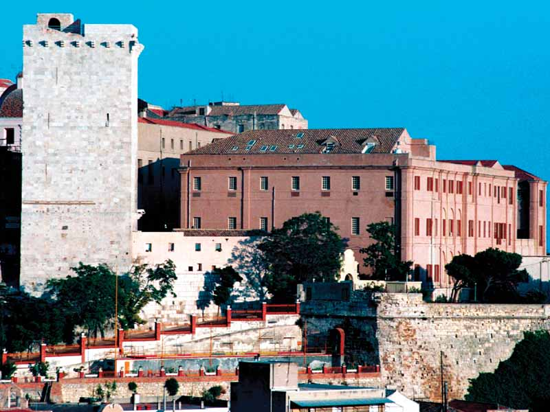
Established in 1620 University campuses: Cagliari, Monserrato, Oristano Multidisciplinary University, with 6 Faculties: - Biology and Pharmacy - Engineering and Architecture - Medicine and Surgery - Sciences - Economics, Law and Political Sciences - Humanities

Slide 3
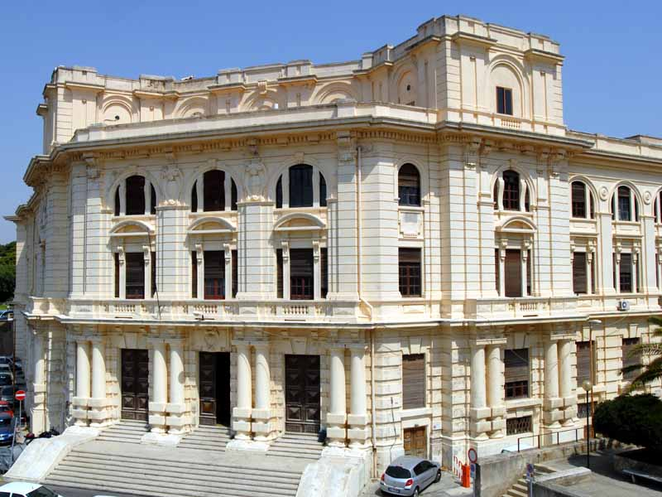
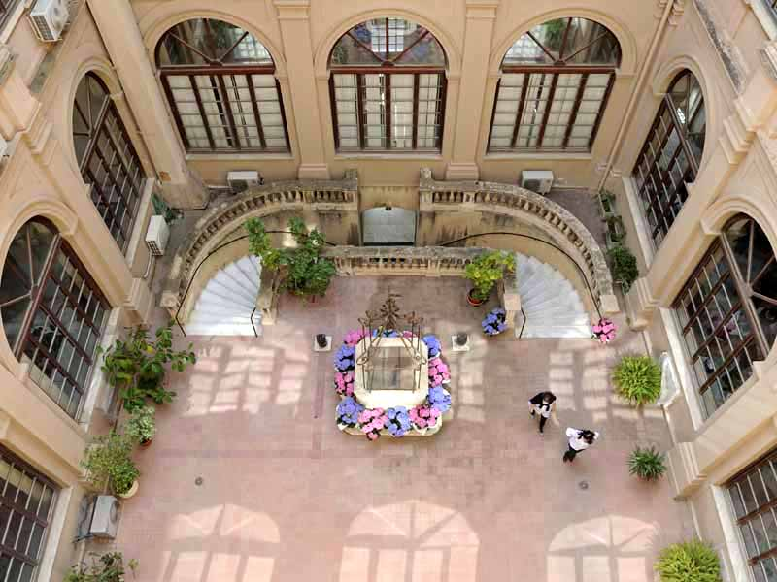
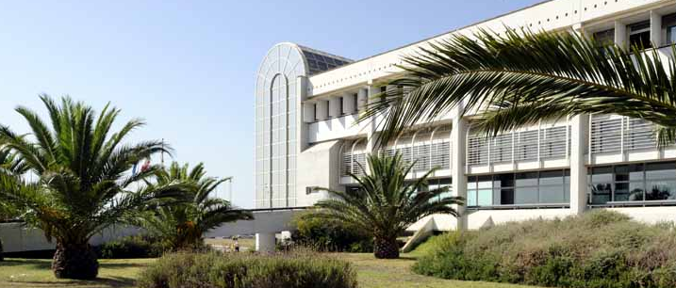
University numbers
Students | 26.000
Number of graduated students in 2015 | 3.892
Faculties/Schools | 6
Teaching and Administrative Staff | 2042
Degree Programmes
First cycle 3-year programmes (Bachelor) | 38 (5 e-learning)
Second cycle programmes (Master’s) | 34
Single cycle programmes | 6 (1 e-learning)
Specialization Schools | 44

Slide 4
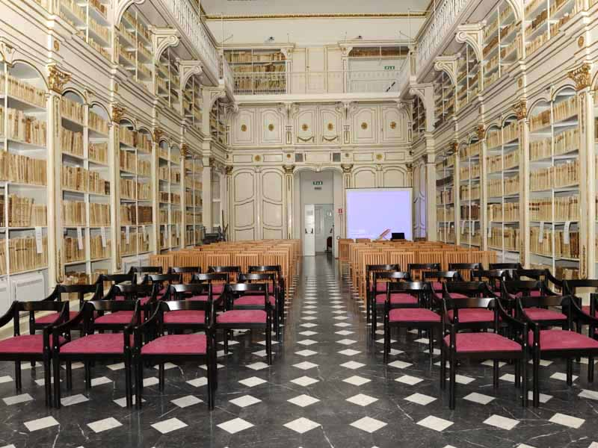
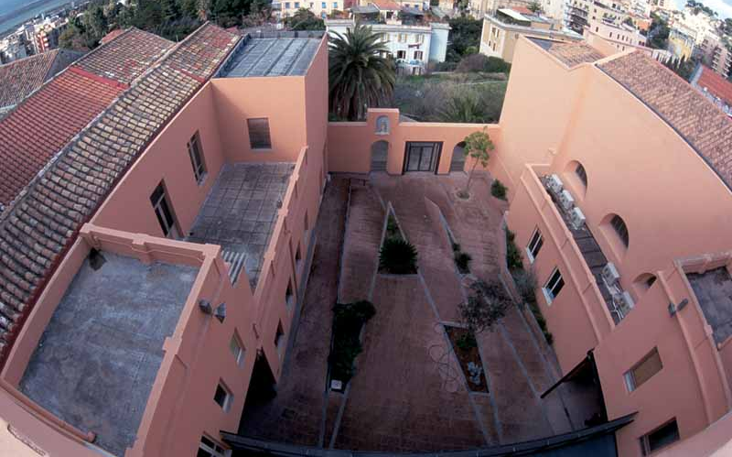
Research
Departments | 17
PhD Programmes | 15
PhD Students | 615
Horizon 2020 Projects short-listed | 10
Horizon 2020 Projects approved | 6
FP7 Projects approved | 32
Spin off | 19
Patents | 27
Research grants | 479
Internationalization
International Framework agreements | 143
Students mobility exchange agreements | 787
Visiting Professors (A.Y. 2014-15) | 114
Exchange students (A.Y. 2015-16) | 400 incoming 1000 outgoing
Courses in English | 22

Slide 5
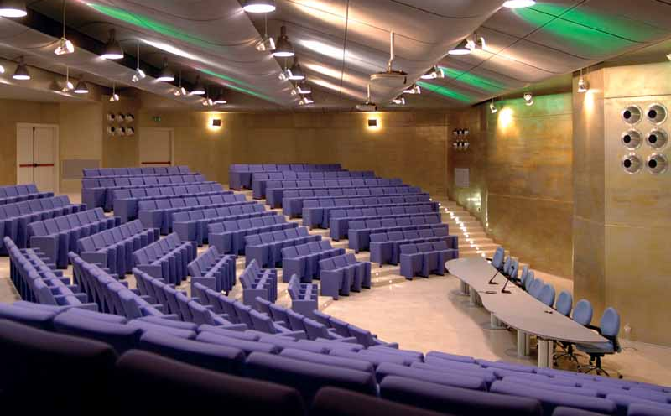
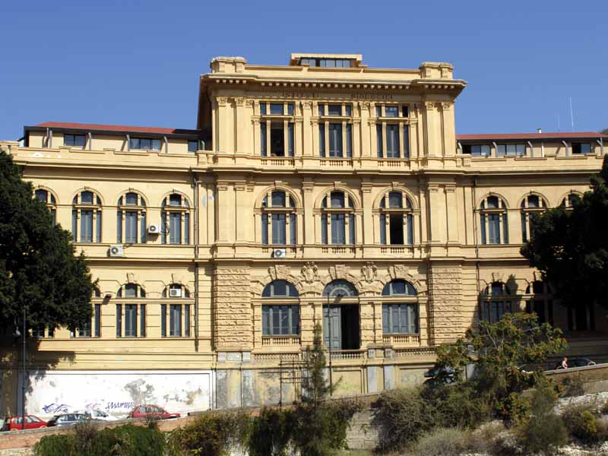
Departments
Philology, Literature, Linguistics
Physics
Law
Civil - Environmental Engineering and Architecture
Electrical and electronic Engineering
Mechanical, chemical and material Engineering
Mathematics and information Technology
Pedagogy, Psychology, Philosophy
Public health, clinical and molecular Medicine
Biomedical Science
Chemical and geological Science
Surgical Science
Environmental and life Science
Economic and business Science
Medical science "Mario Aresu"
Social and institutional Science
History, cultural and territorial Heritage

Slide 6
N of Universities/Country
Cooperation Framework agreements

Slide 7
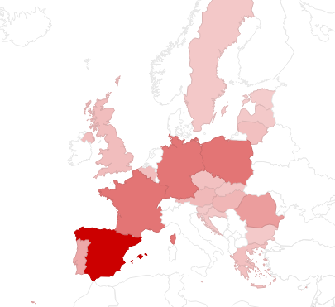
Student mobility: Erasmus+ exchange agreements
Austria | 15
Belgio | 11
Bulgaria | 3
Cipro | 2
Croazia | 4
Estonia | 1
Finlandia | 2
Francia | 64
Germania | 63
Grecia | 10
Irlanda | 1
Latvia | 3
Liechtenstein | 1
Lituania | 10
Malta | 4
Norvegia | 2
Olanda | 2
Polonia | 64
Portogallo | 27
Regno Unito | 12
Repubblica Ceca | 9
Romania | 35
Slovaccia | 6
Slovenia | 3
Spagna | 148
Svezia | 4
Svizzera | 3
Turchia | 30
Ungheria | 17
TOT: 721 AGREEMENTS

Slide 8
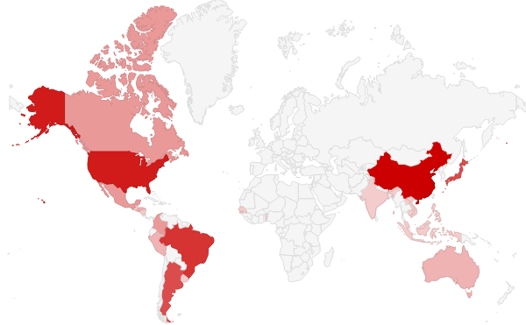
Student mobility: Globus exchange agreements
Argentina | 6
Australia | 2
Benin | 1
Brasile | 7
Cambogia | 1
Canada | 3
Cile | 2
Cina | 9
Colombia | 3
El Salvador | 2
Filippine | 1
Giappone | 6
Guatemala | 1
Honduras | 2
India | 1
Indonesia | 1
Laos | 1
Malesia | 1
Messico | 3
Nicaragua | 1
Peru | 2
Senegal | 1
Uruguay | 1
Usa | 8
Vietnam | 1
TOTALE | 67
4 Erasmus Mundus partnership for mobility
EMA2 (MOVER, DREAM, LAMENITEC, MARHABA)
Project SARDEGNA FORMED (Algeria, Marocco, Tunisia)

Slide 9
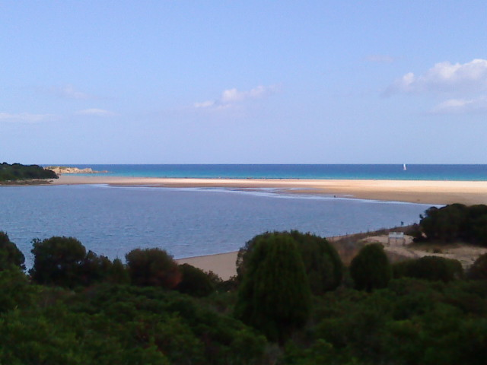

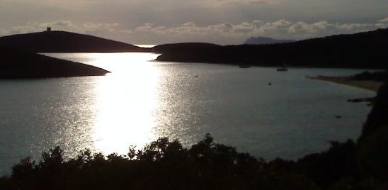
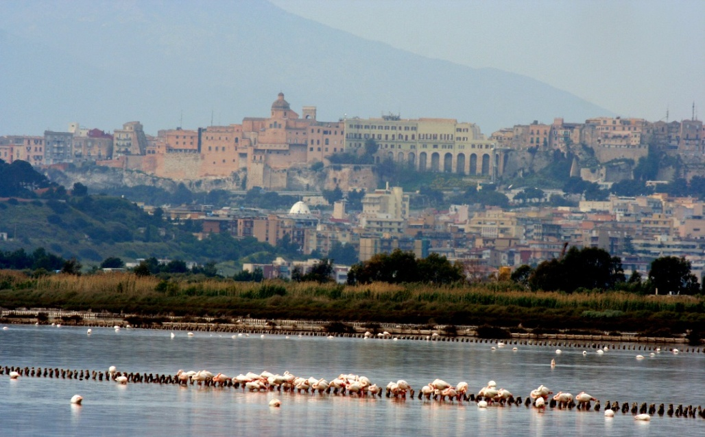
Welcome to UniCA
Welcome to Sardinia!

